Slide 1

Machine Learning Algorithms Decision Tree and Support Vector Machine
Raghu Prasad Konandur
9845547471
www.kaushalya.tech
raghuprasadkonandur@kaushalya.tech

Slide 2
Introduction
Raghu Prasad – BE, MS
Total of 27 years of experience
7 years as a lecturer in an Engineering College
20 Years into IT
Worked with companies like CISCO,CSC,ICICI,First Apex – NTT Data
Currently into Corporate training and consultancy
Worked with corporates and public sector
Service Offerings – In person/On-line/Corporate/Academic Institutes
Consultancy – Consultant to vendor of Atal Tinkering Lab/ECIL-ECIT, Incarnus – Healthcare Service Provider
Technologies – Java,Python,Web technologies,Java Script technologies (MEAN stack),IOT,Test Automation,Machine Learning,Artificial Intelligence,ERP,.NET
Customers – Philips,L & T,NextGen,Incarnus,Aspire system,BGS-IT,Sindhi College,Malnad Enginering College,S B College of Management, REVA University,Nagarjuna Engineering College,Dayanand Sagar University,Acharya Institute of Technology,NIE Mysore,NIT-Imphal,etc

Slide 3
Topics
Supervised machine learning
Decision Tree
Support Vector Machine

Slide 4
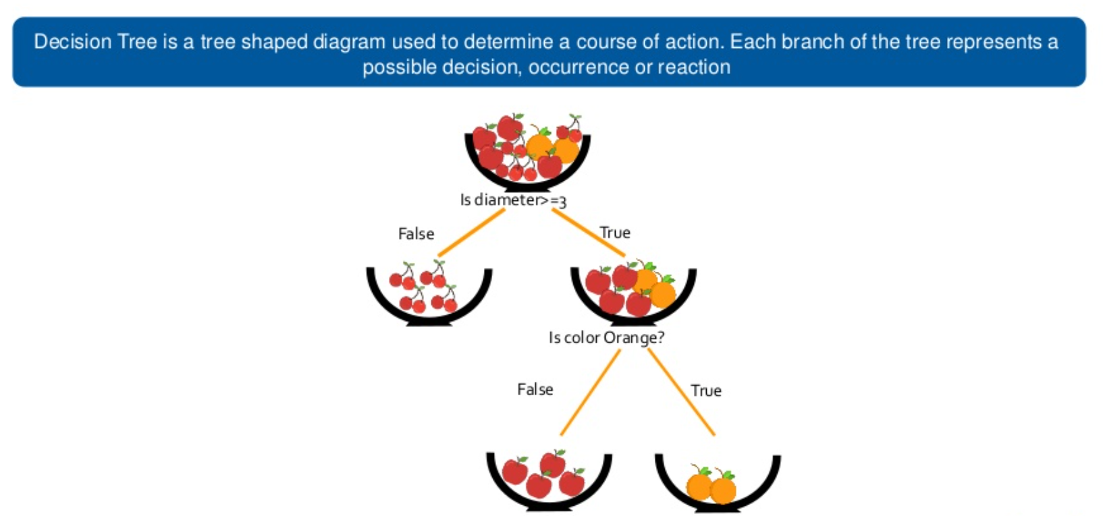
Decision Tree

Slide 5
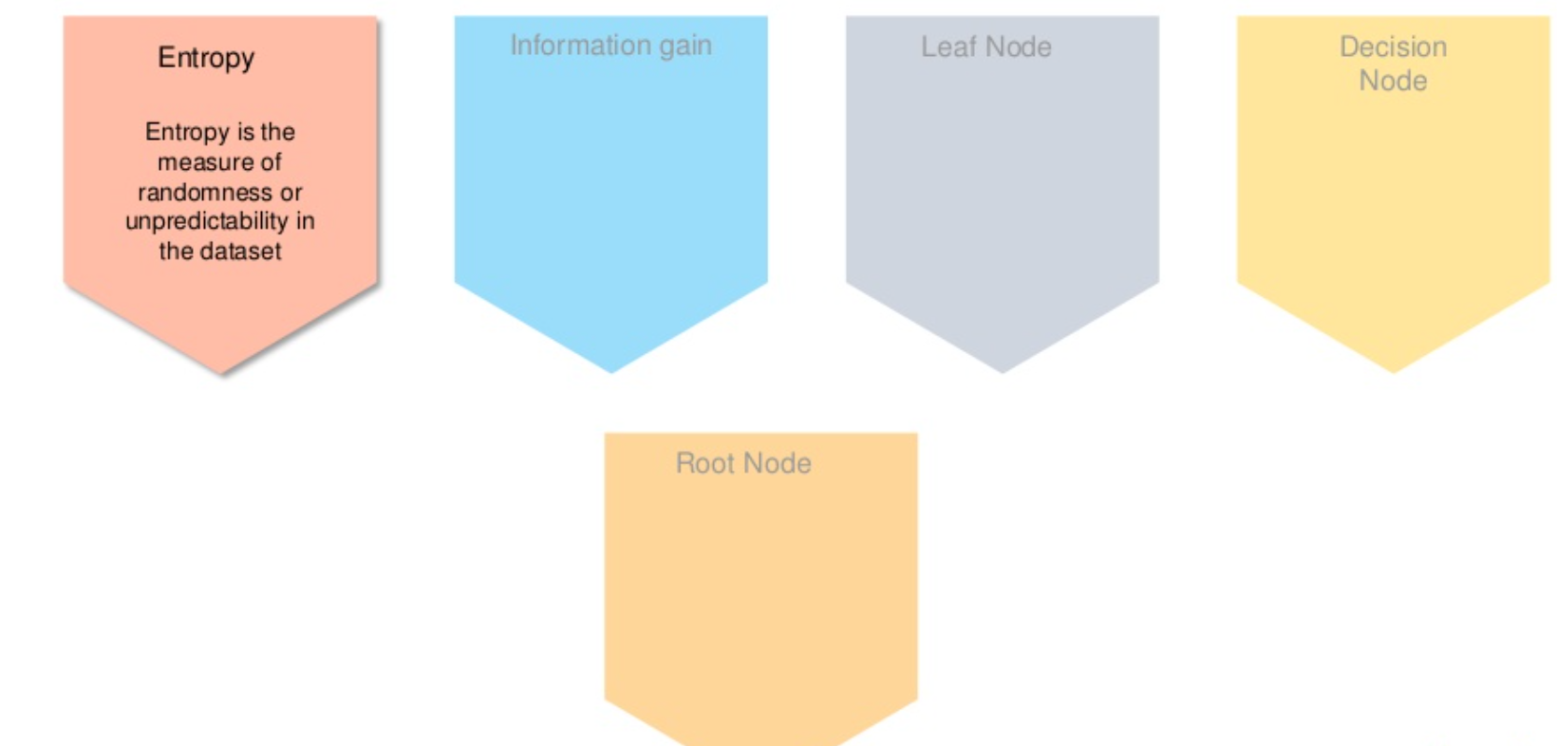
Decision Tree – Important terms

Slide 6
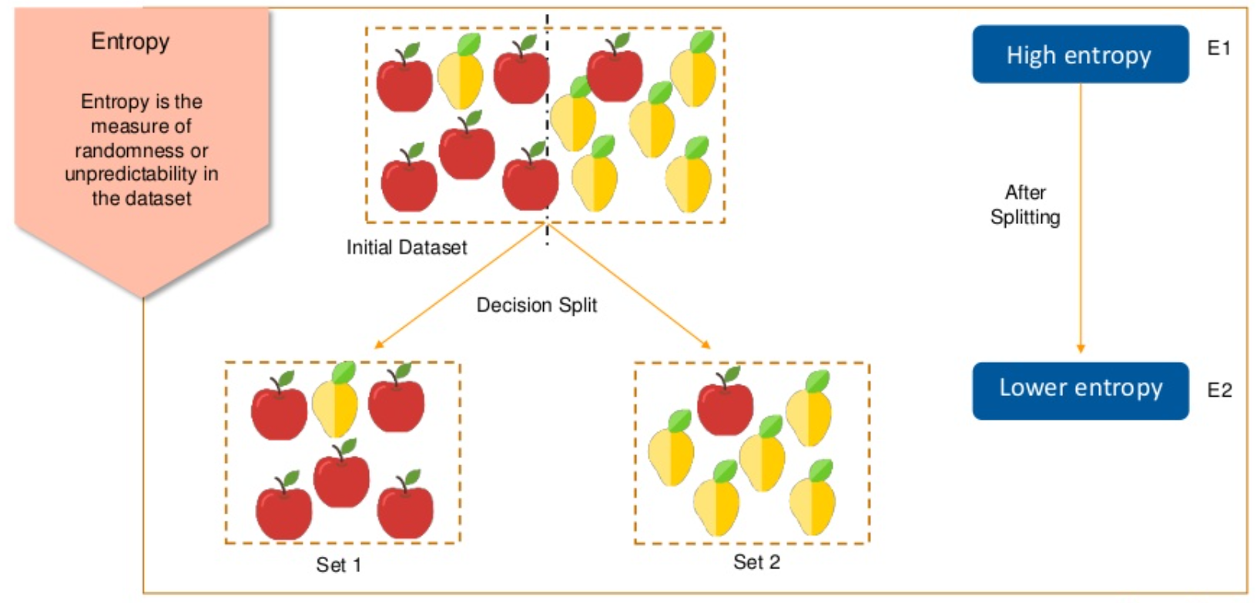
Decision Tree – Important terms

Slide 7
Decision Tree – Important terms

Slide 8
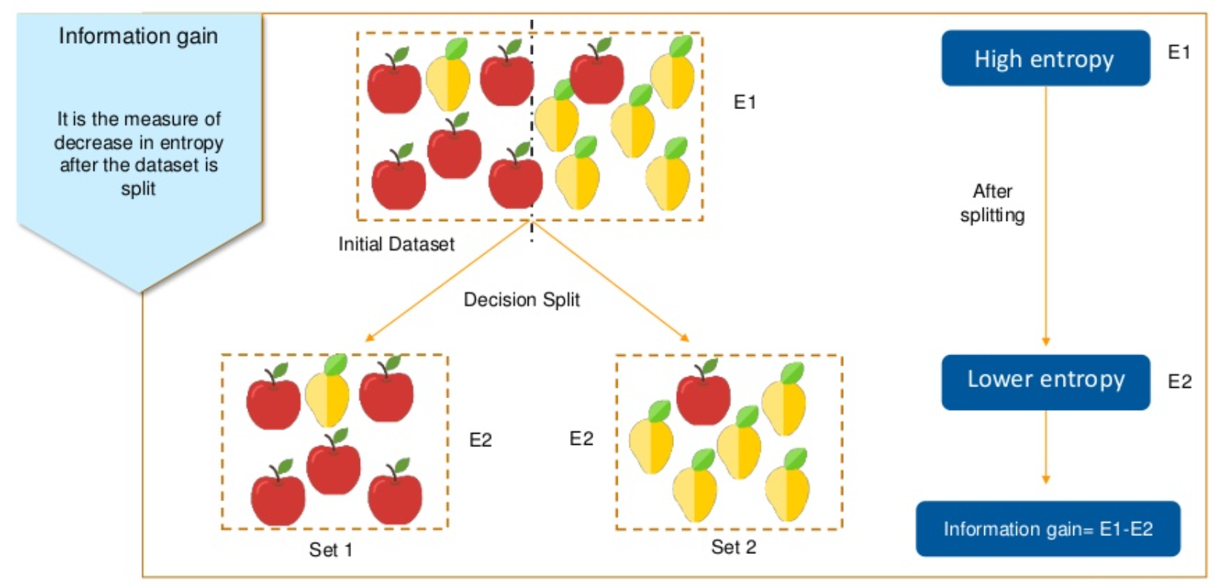
Decision Tree – Important terms

Slide 9
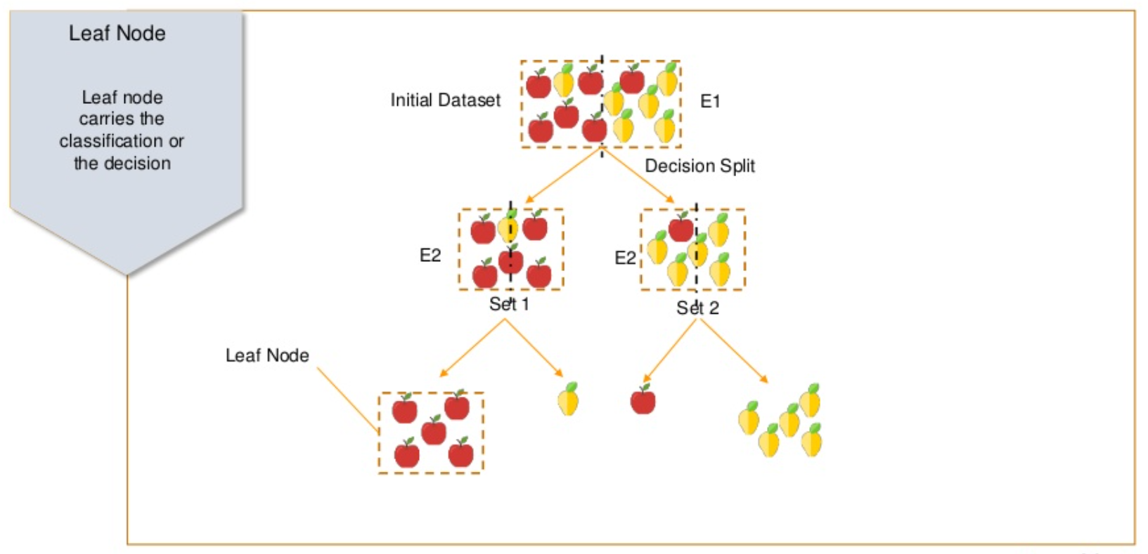
Decision Tree – Important terms

Slide 10
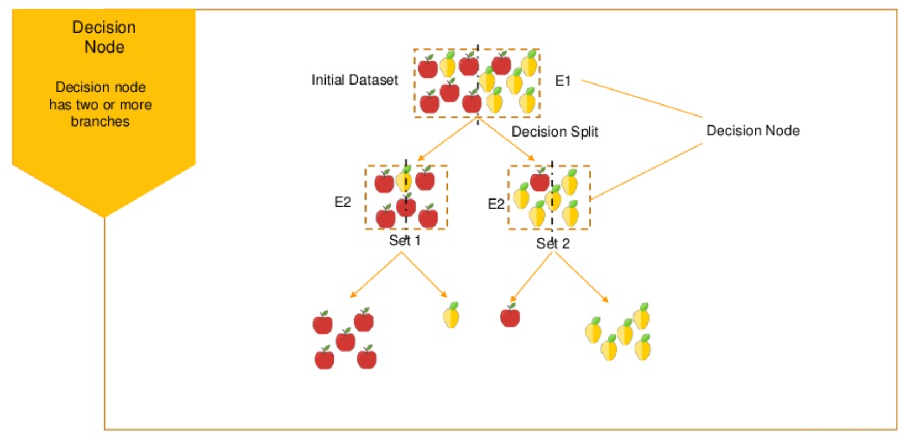
Decision Tree – Important terms

Slide 11
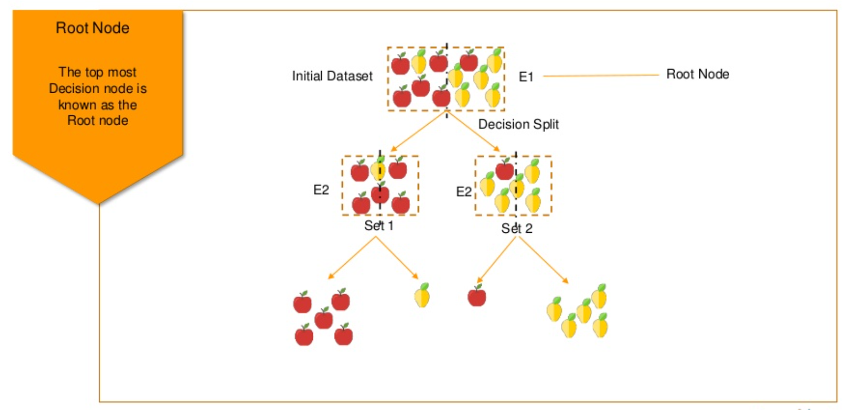
Decision Tree – Important terms

Slide 12
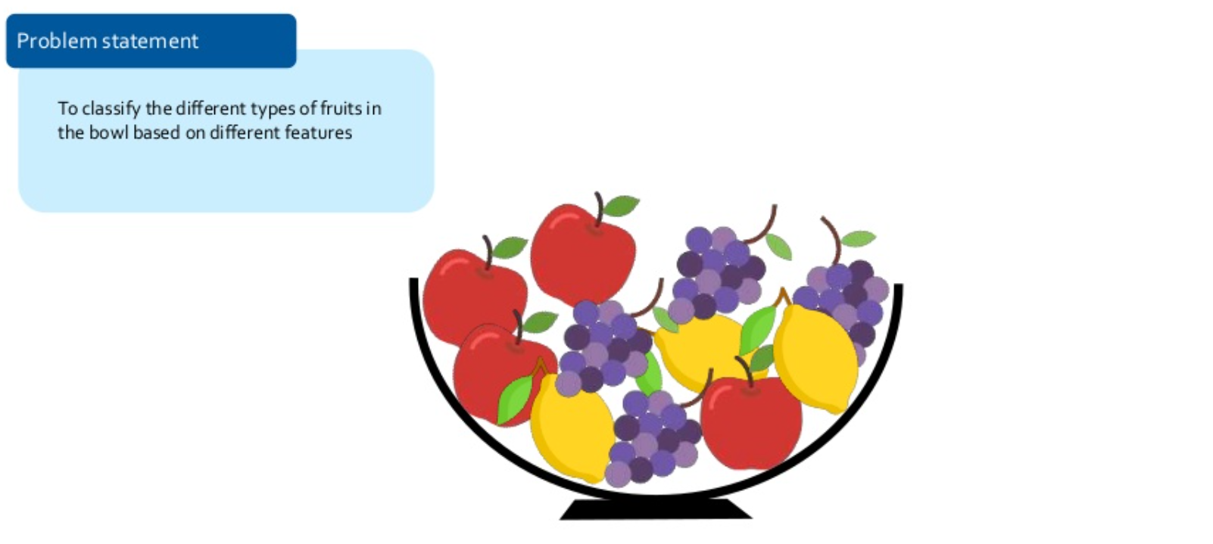
Decision Tree – How it works ?

Slide 13
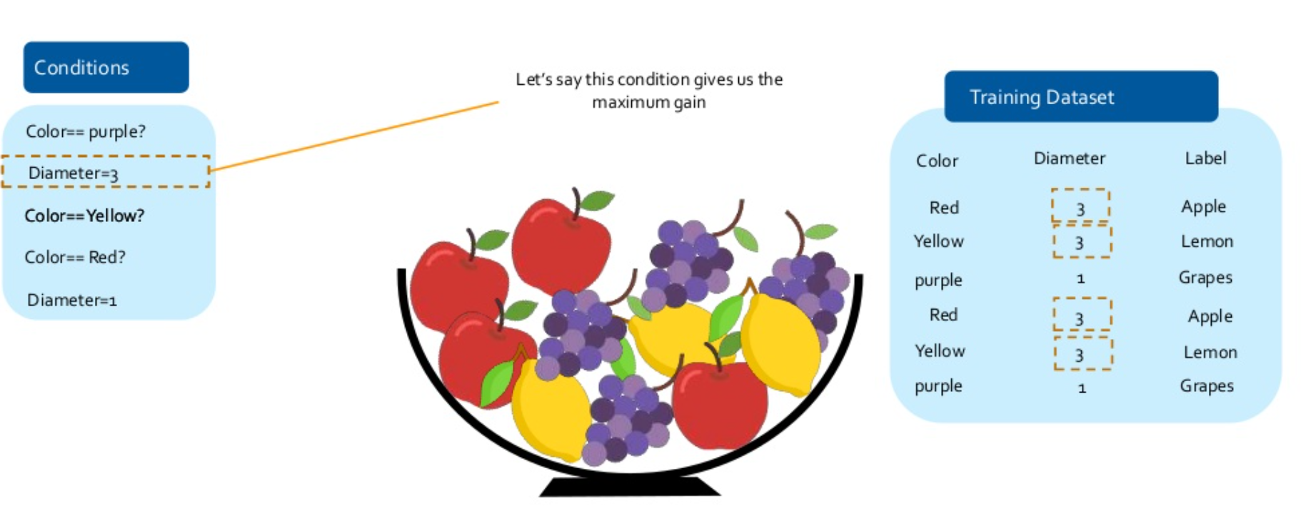
Decision Tree – How it works ?

Slide 14
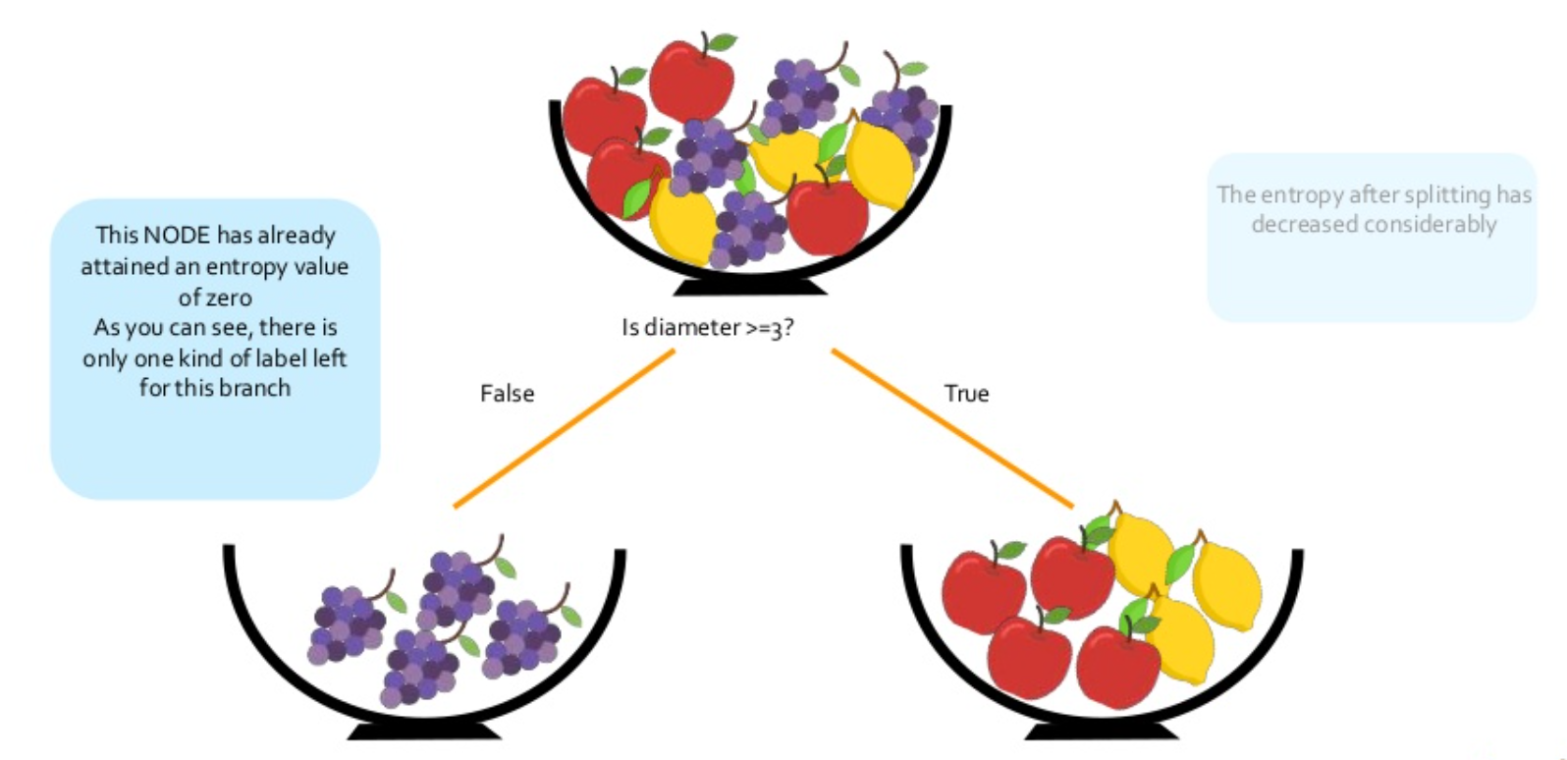
Decision Tree – How it works ?

Slide 15
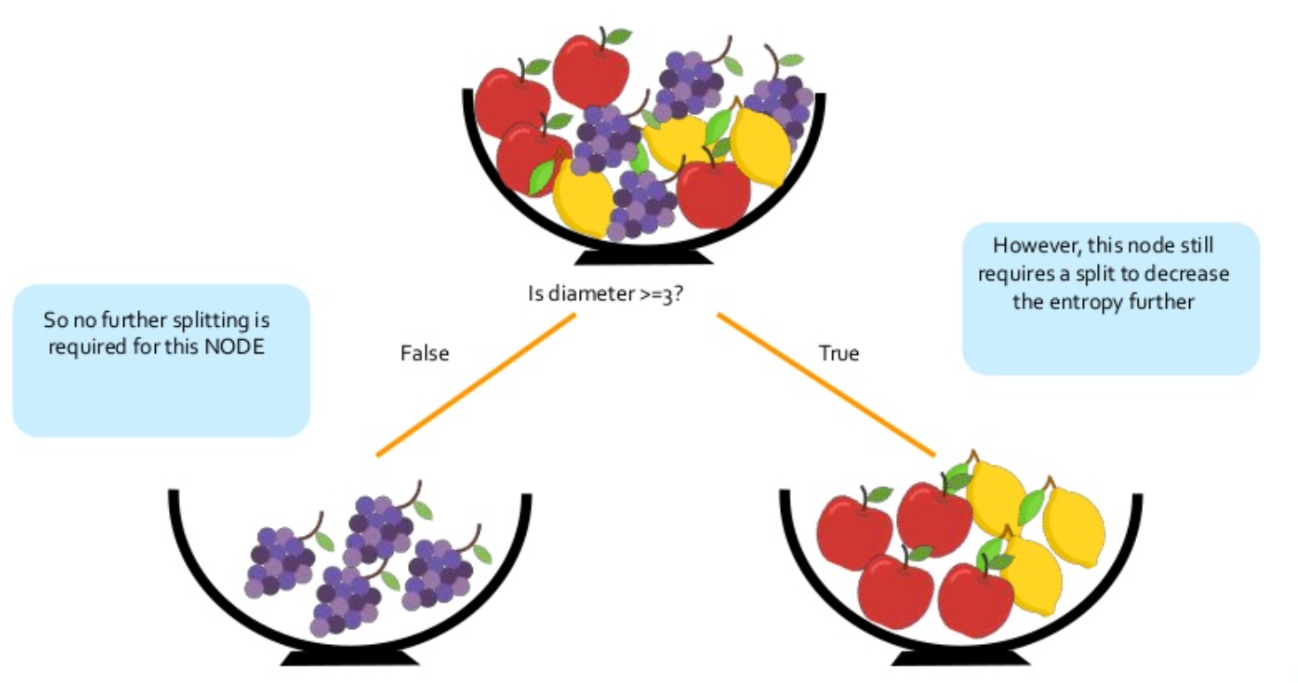
Decision Tree – How it works ?

Slide 16
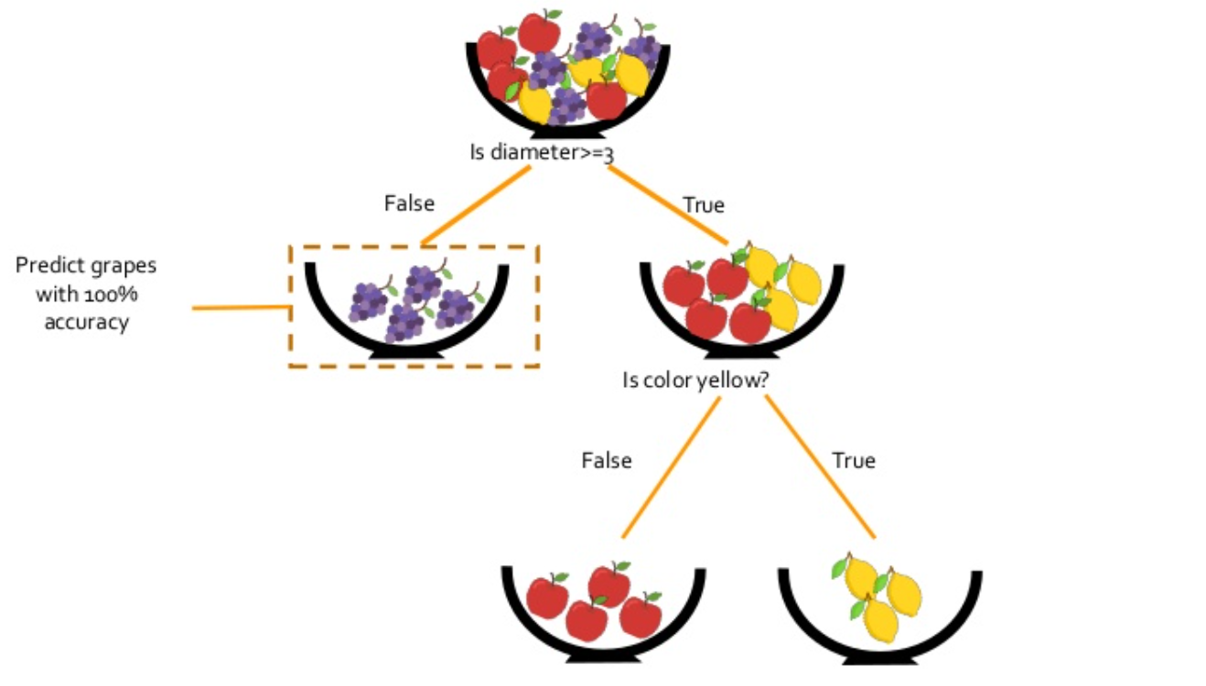
Decision Tree – How it works ?

Slide 17
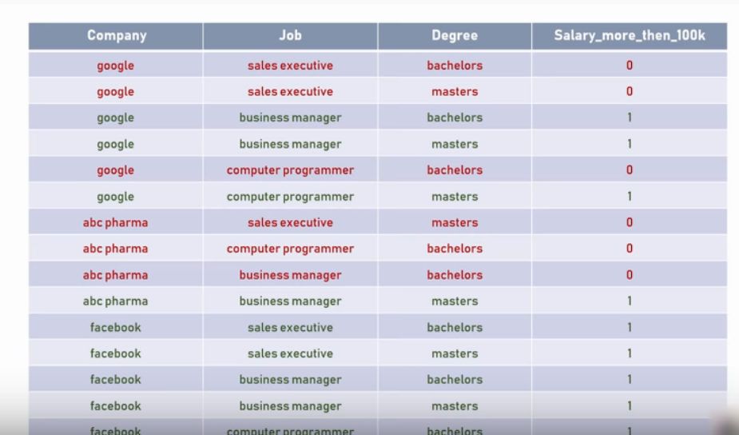
Decision Tree – Use Case

Slide 18
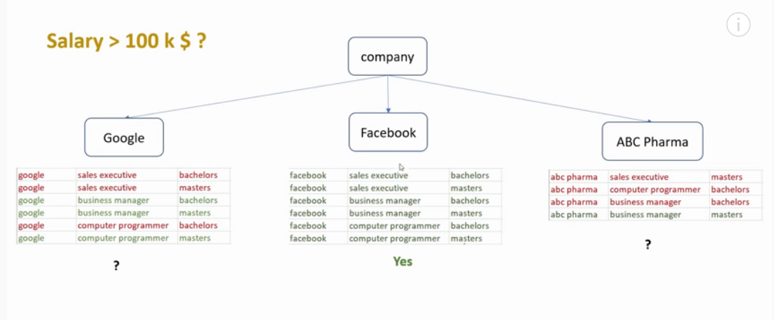
Decision Tree

Slide 19
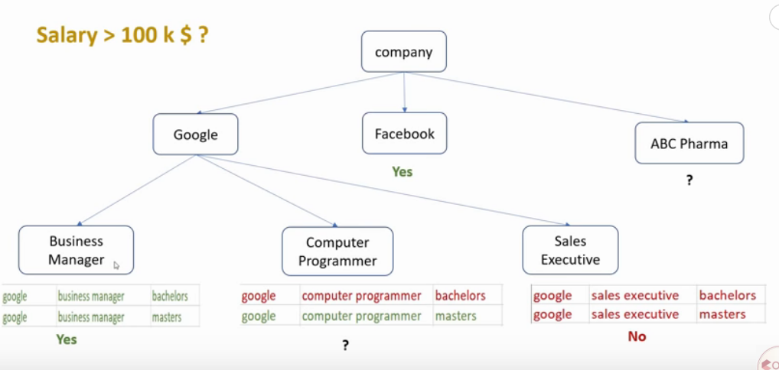
Decision Tree

Slide 20
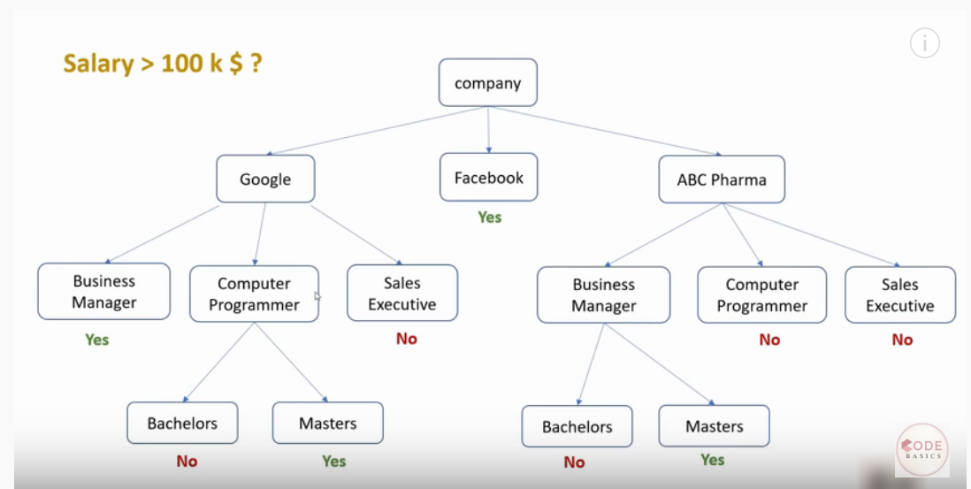
Decision Tree

Slide 21
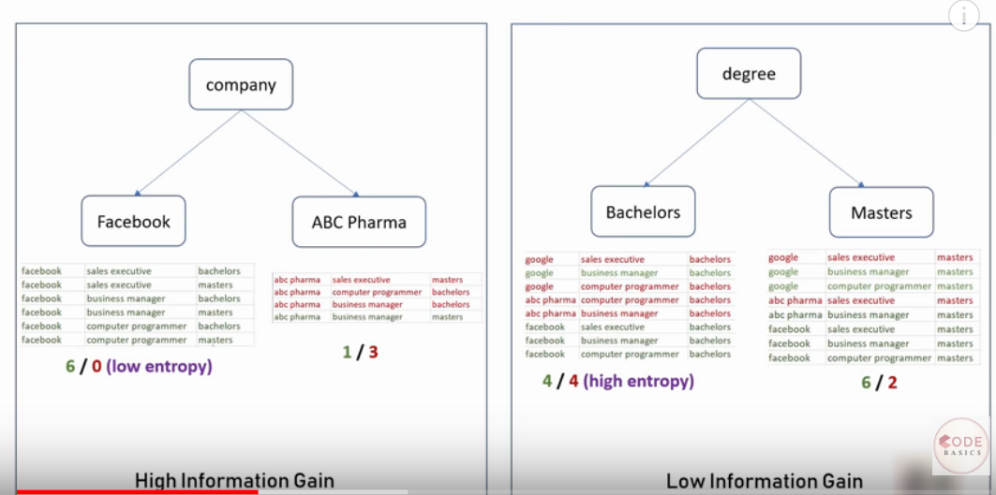
Decision Tree

Slide 22
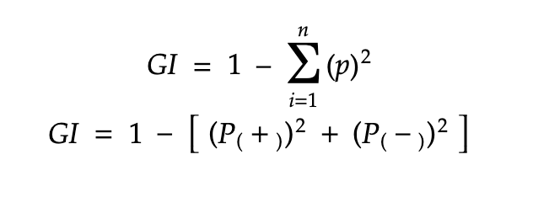
Decision Tree – Entropy Vs Gini Impurity
Entropy can be defined as a measure of the purity of the sub split. Entropy always lies between 0 to 1. The entropy of any split can be calculated by this formula.

Slide 23
Decision Tree – Entropy Vs Gini Impurity
Gini Impurity: The internal working of Gini impurity is also somewhat similar to the working of entropy in the Decision Tree. In the Decision Tree algorithm, both are used for building the tree by splitting as per the appropriate features but there is quite a difference in the computation of both the methods. Gini Impurity of features after splitting can be calculated by using this formula.

Slide 24
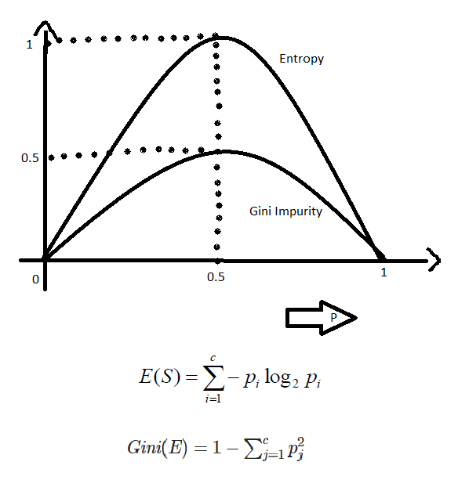
Decision Tree – Entropy Vs Gini Impurity

Slide 25
Decision Tree – Entropy Vs Gini Impurity
The internal working of both methods is very similar and both are used for computing the feature/split after every new splitting. But if we compare both the methods then Gini Impurity is more efficient than entropy in terms of computing power. As you can see in the graph for entropy, it first increases up to 1 and then starts decreasing, but in the case of Gini impurity it only goes up to 0.5 and then it starts decreasing, hence it requires less computational power. The range of Entropy lies in between 0 to 1 and the range of Gini Impurity lies in between 0 to 0.5. Hence we can conclude that Gini Impurity is better as compared to entropy for selecting the best features.

Slide 26
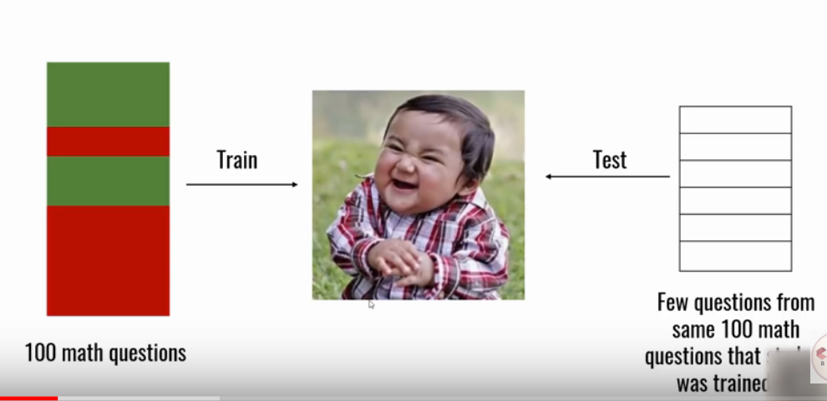
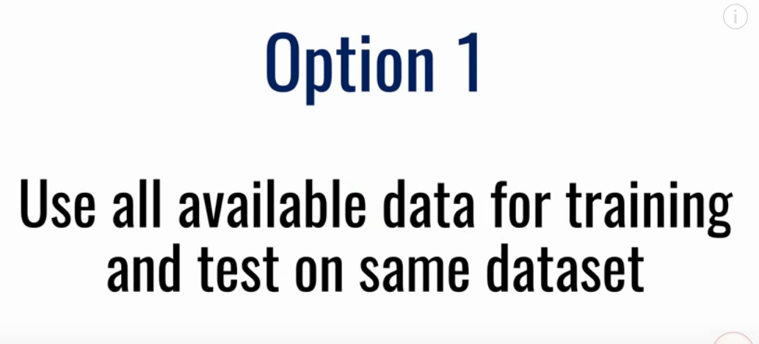
Cross Validation – Evaluating model performance

Slide 27
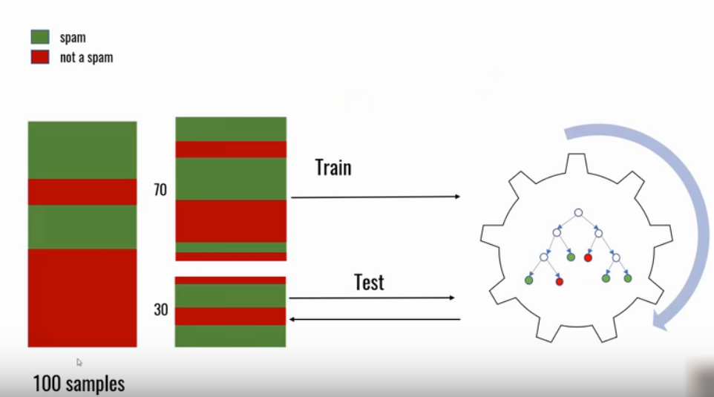
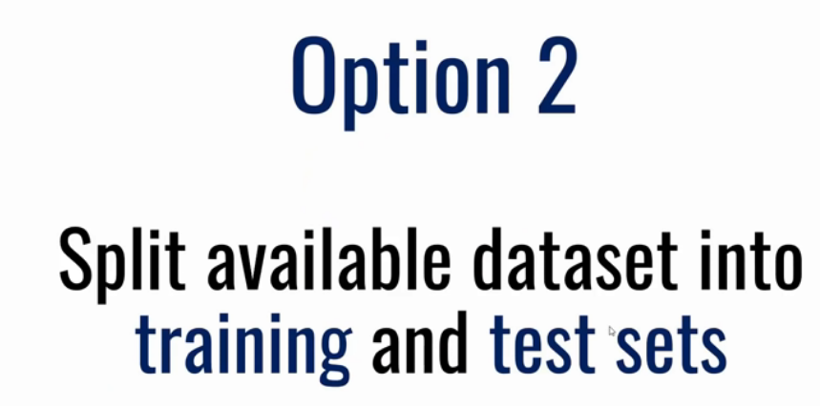
Cross Validation – Evaluating model performance

Slide 28
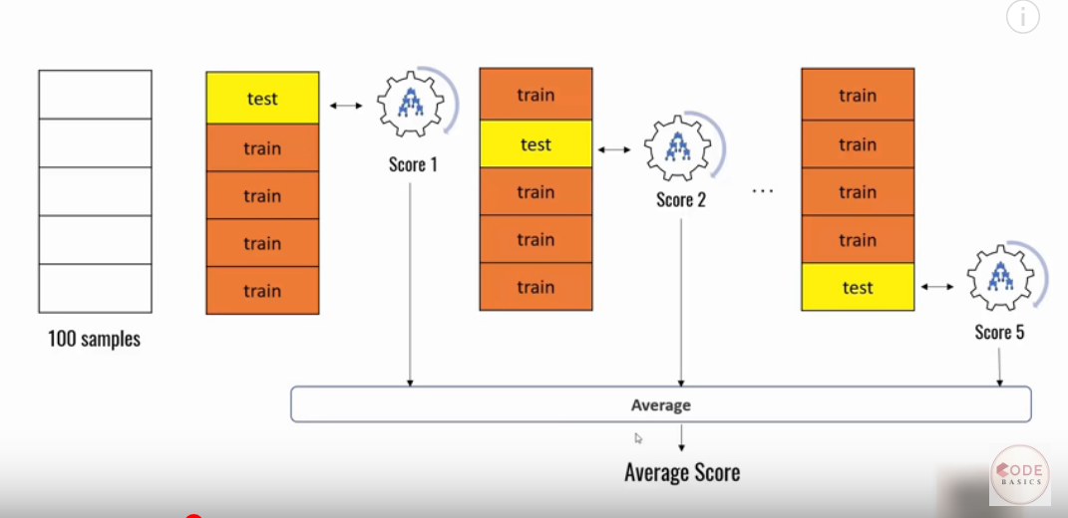
Cross Validation – Evaluating model performance – Option 3

Slide 29
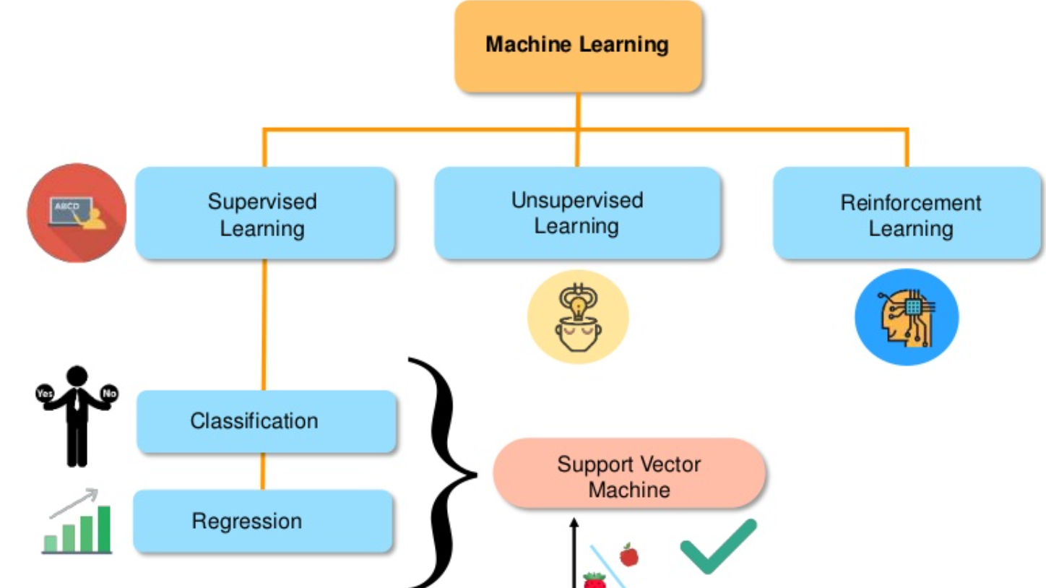
Support Vector Machine (SVM)

Slide 30
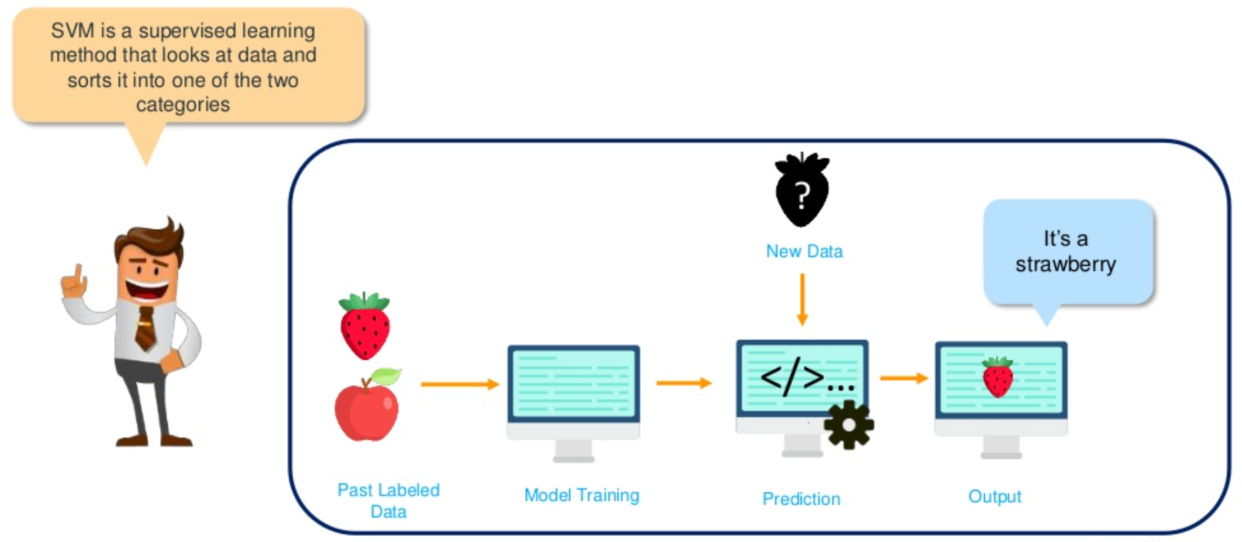
Support Vector Machine (SVM)

Slide 31
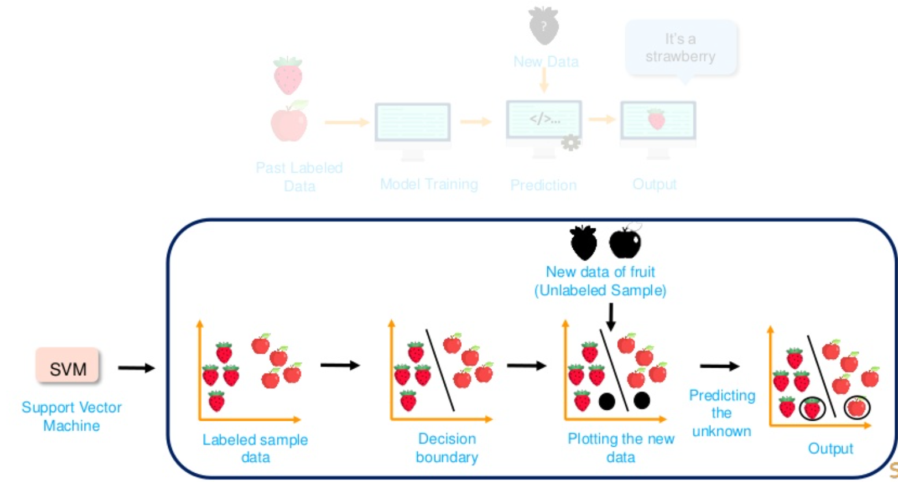
Support Vector Machine (SVM)

Slide 32
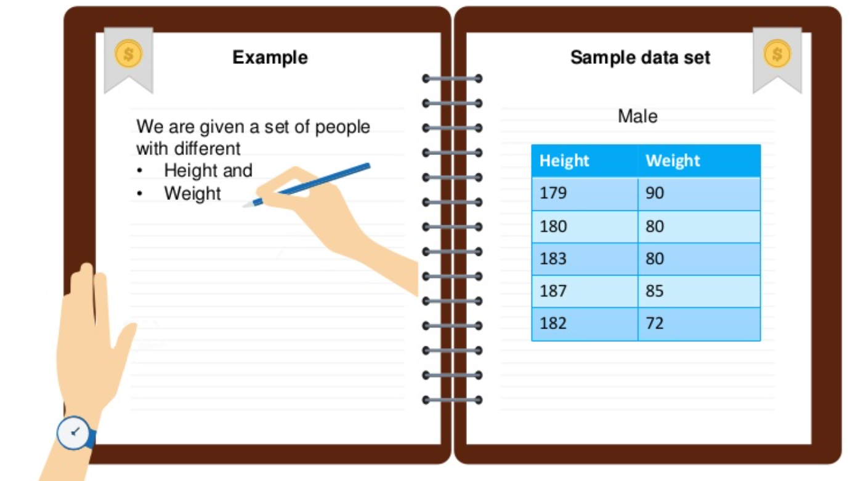
Support Vector Machine (SVM)

Slide 33
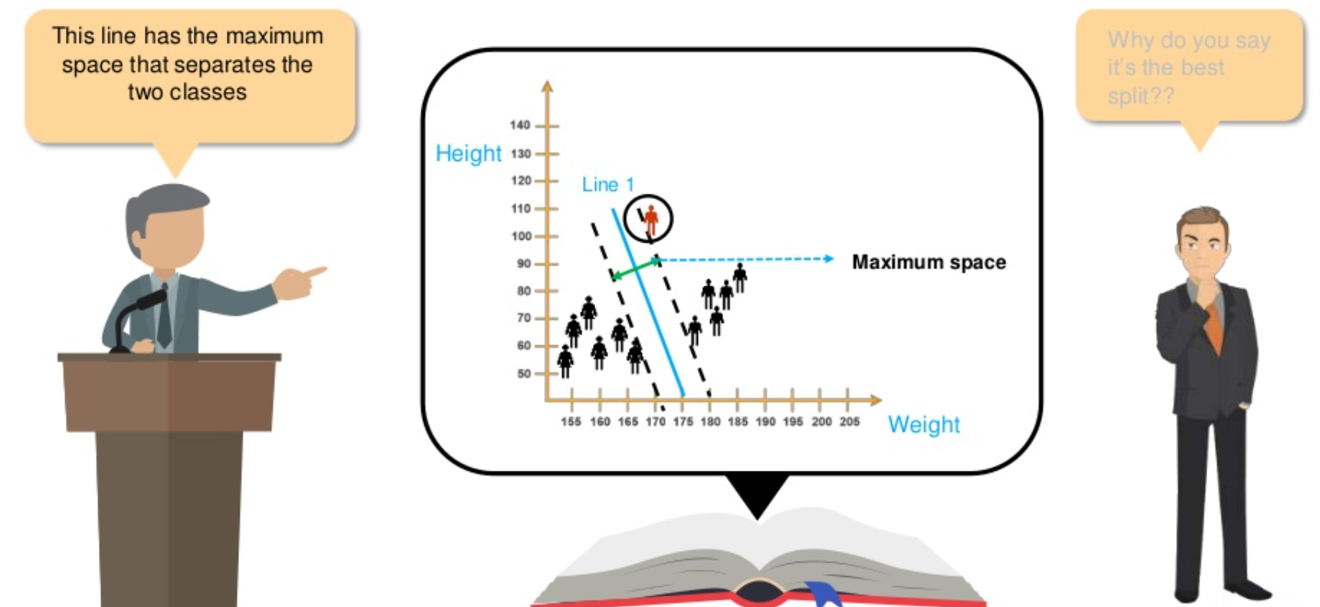
Support Vector Machine (SVM)

Slide 34
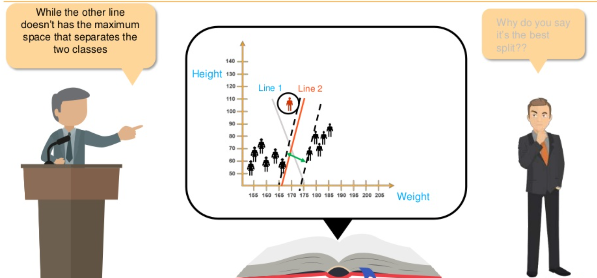
Support Vector Machine (SVM)

Slide 35
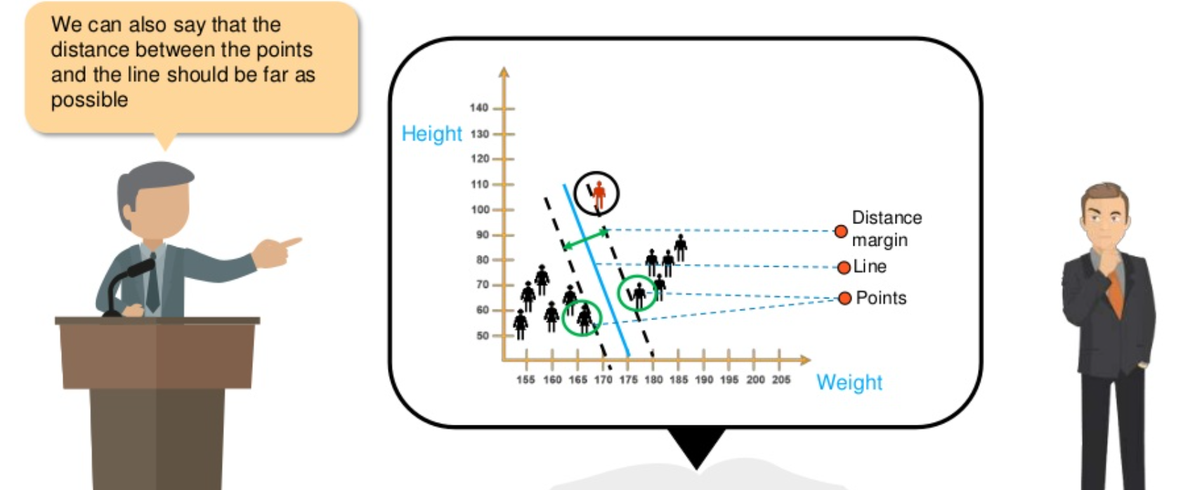
Support Vector Machine (SVM)

Slide 36
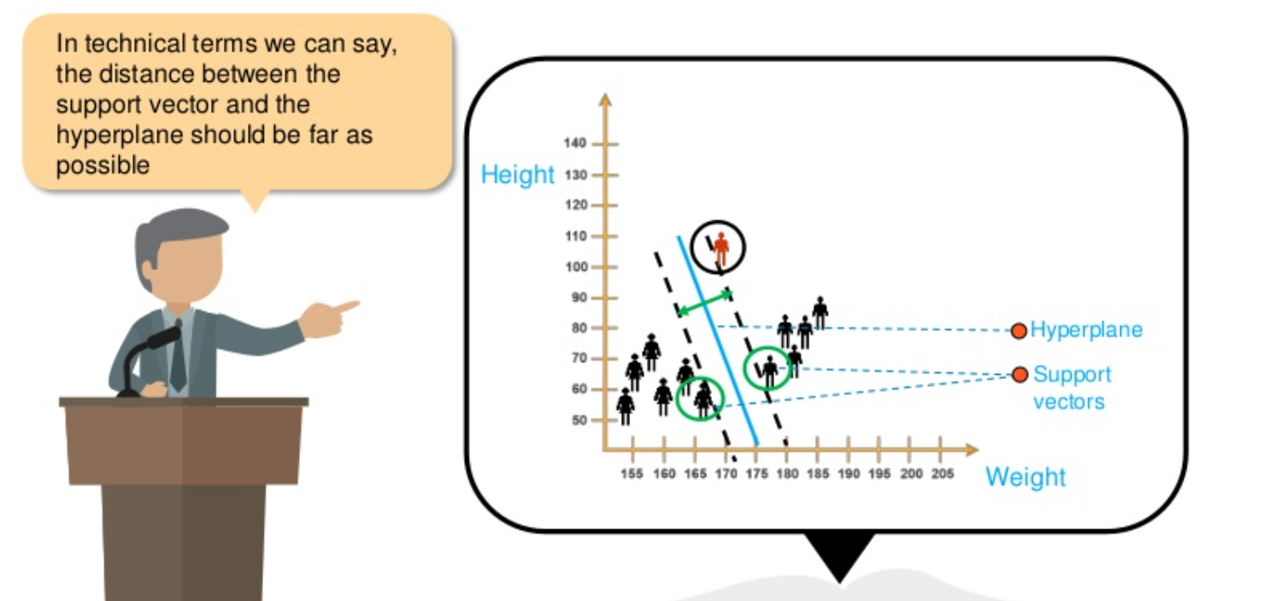
Support Vector Machine (SVM)

Slide 37
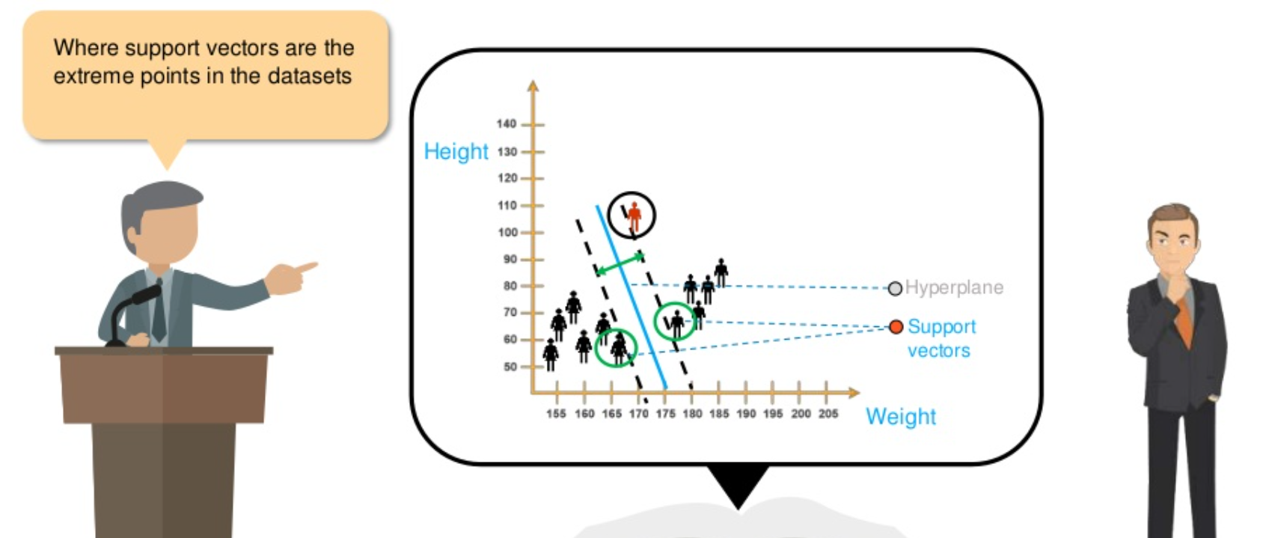
Support Vector Machine (SVM)

Slide 38
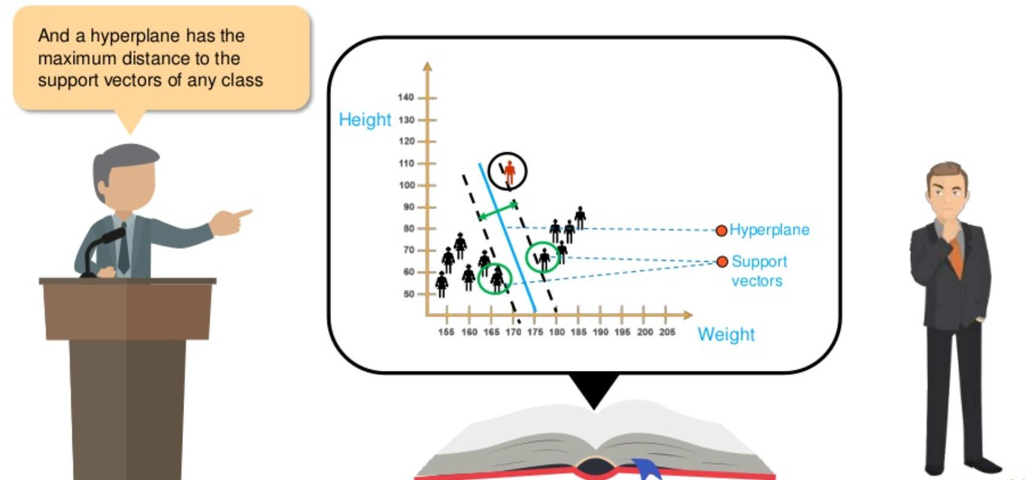
Support Vector Machine (SVM)

Slide 39
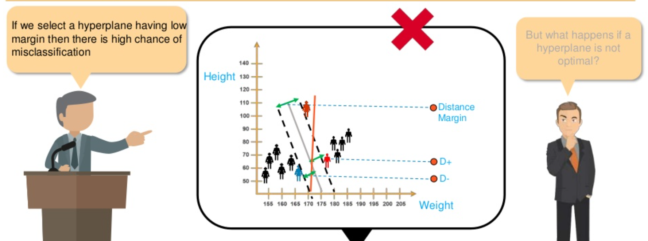
Support Vector Machine (SVM)

Slide 40
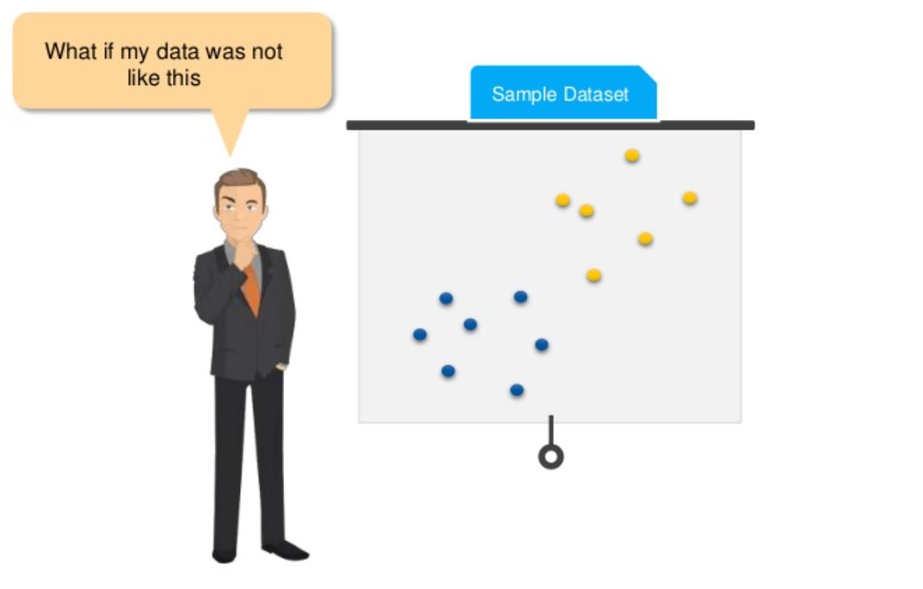
Support Vector Machine (SVM)

Slide 41
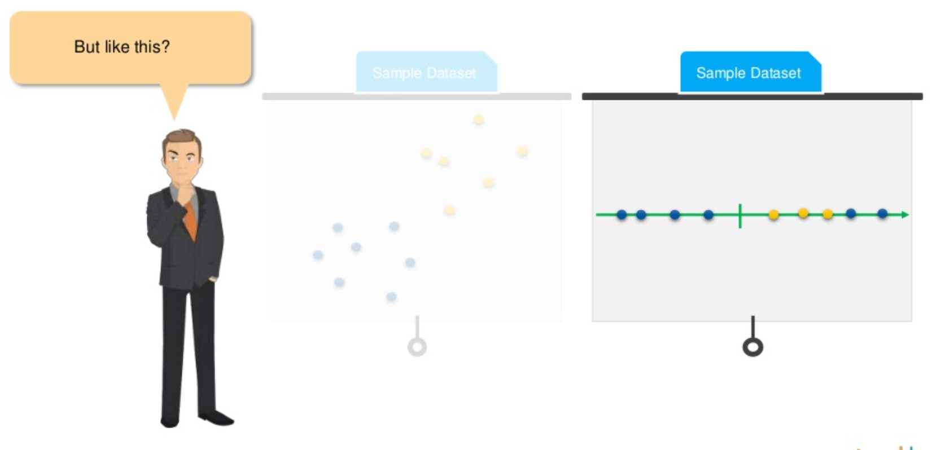
Support Vector Machine (SVM)

Slide 42
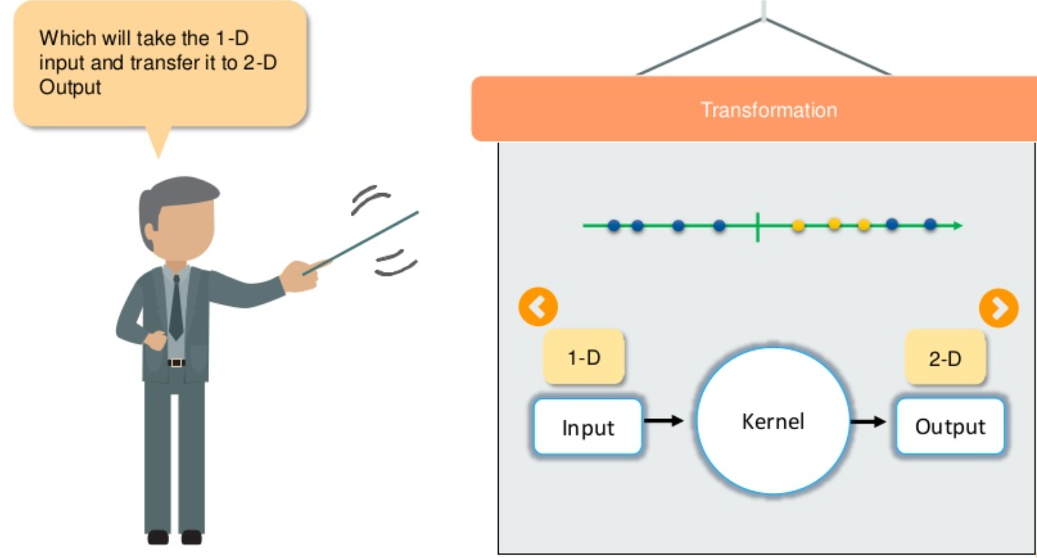
Support Vector Machine (SVM)

Slide 43
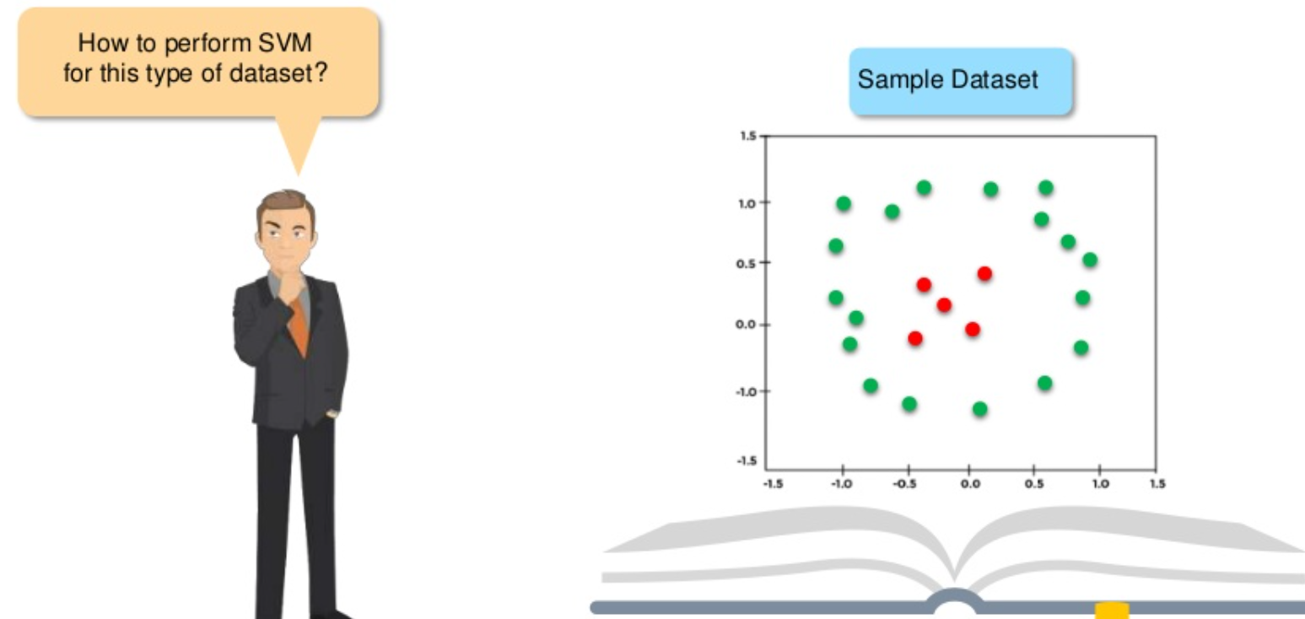
Support Vector Machine (SVM)

Slide 44
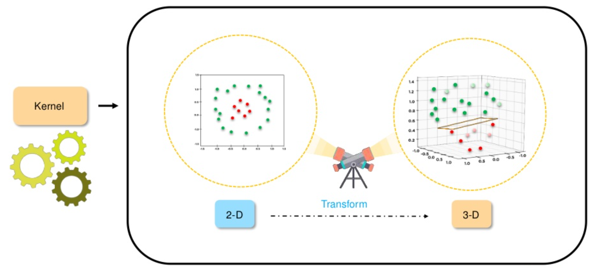
Support Vector Machine (SVM)

Slide 45
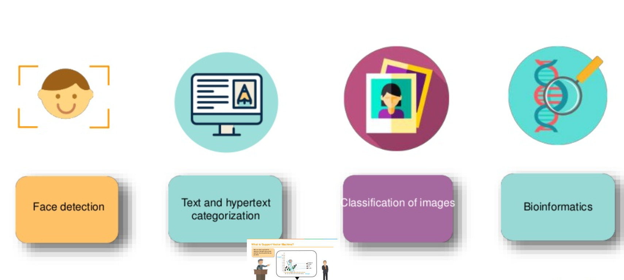
Applications of Support Vector Machine (SVM)

Slide 46
Hands-on session
Decision Tree
SVM

Slide 47
References
https://www.skillbasics.com/
https://www.slideshare.net/Simplilearn/support-vector-machine-how-support-vector-machine-works-svm-in-machine-learning-simplilearn
https://www.geeksforgeeks.org/decision-tree-introduction-example/
https://www.geeksforgeeks.org/regularization-in-machine-learning/

Slide 48
Thank You
Raghu Prasad Konandur
9845547471
www.kaushalya.tech
raghuprasadkonandur@kaushalya.tech

